Slide 1
Input-Output Organization

Slide 2
What is Input Output Subsystem?
The I/O subsystem is a component of computer system design that provides an efficient mode of communication between the central system and the outside environment.
It handles all the input- output operations of the computer system. The I/O subsystem includes disc controllers, tape drives, discs, system buses, and other devices.
The I/O subsystem allows the user to communicate with the machine.
The I/O subsystem has three major components:
I/O Hardware Interface-I/O hardware consists of a mouse, disk, keyboard. The device driver enables communication between the I/O devices and the operating system.
I/O Software Interface-It refers to a set of instructions written to interact with I/O devices such as keyboard, USB devices, mouse, printers and so forth.

Slide 3
The key goal of I/O software is to achieve device independence which makes it possible to construct a set of programs that allow access to any I/O device without need of specifying the device in advance.
I/O Application Interface- The I/O Application interface refers to the medium through which data is being transferred between external I/O devices and internal storage.
Each peripheral device that is connected or linked to a computer system needs a certain communication link to interact with the CPU.
I/O (input/output) subsystem provides efficient communication between the computer system and the outside environment.
It is responsible for handling or controlling overall input-output operations in the computer system.

Slide 4
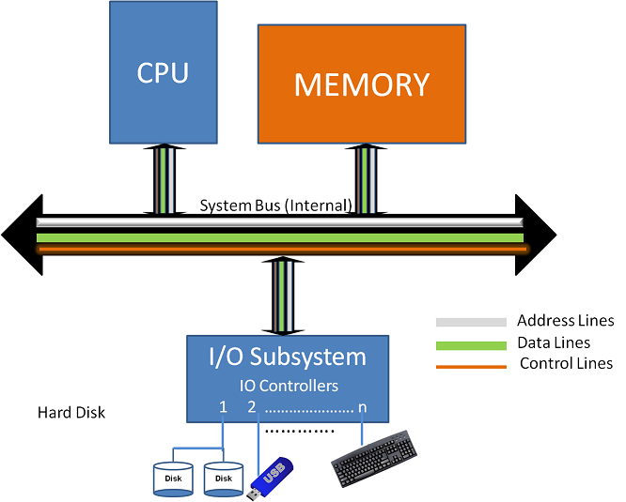
Architecture of Input-Output Subsystem

Slide 5
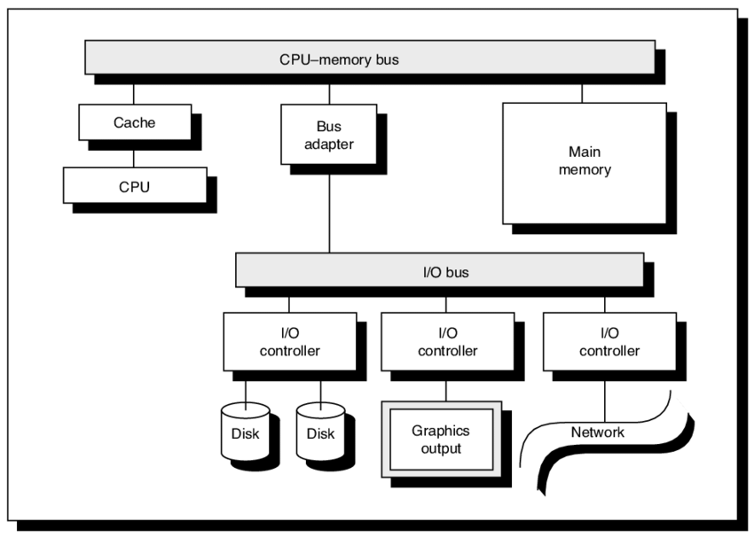
The system bus, disc controllers, discs, tape drives, and other I/O devices comprise the I/O (input/output) subsystem.

Slide 6
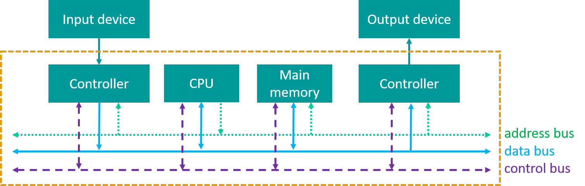
System Bus

Slide 7
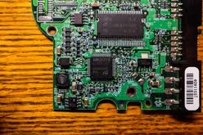
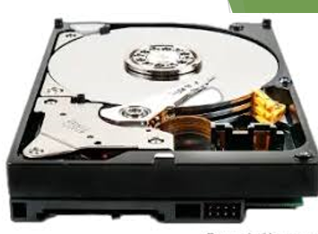
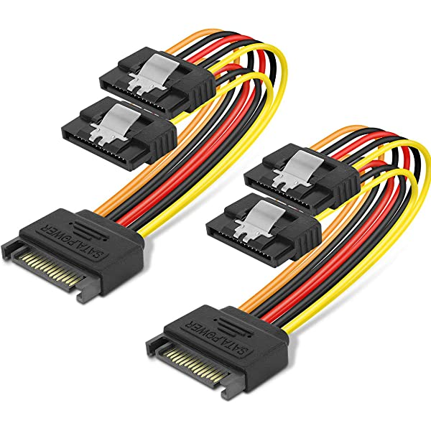
Disc Controller Card
Hard Disc
Disc Cable or adpater

Slide 8
Peripheral Devices
Input or output devices that are connected to computer are called peripheral devices.
These devices are designed to read information into or out of the memory unit upon command from the CPU and are considered to be the part of computer system.
For example: Keyboards, display units and printers are common peripheral devices.
Types of peripherals:
1. Input peripherals : Allows user input, from the outside world to the computer. Example: Keyboard, Mouse etc.
2. Output peripherals: Allows information output, from the computer to the outside world. Example: Printer, Monitor etc

Slide 9
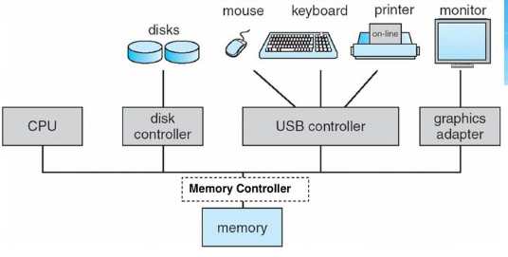
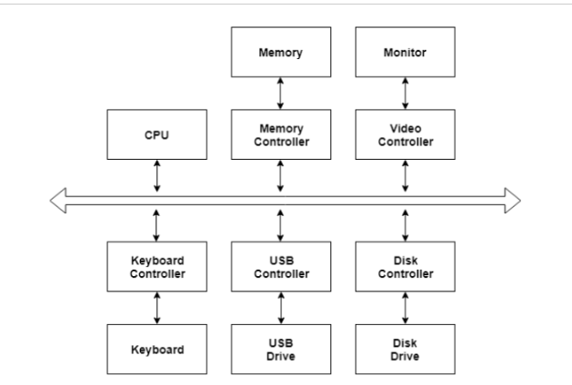
I/O Hardware
I/O Hardware is a set of specialized hardware devices that help the operating system access disk drives, printers, and other peripherals.
There are different device drivers that can be connected to the operating system to handle a specific device. The device controller is an interface between the device and the device driver.

Slide 10
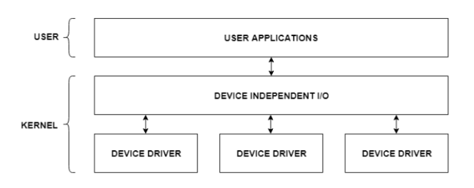
I/O Application Interface
The user applications can access all the I/O devices using the device drivers, which are device specific codes. The application layer sees a common interface for all the devices.
Most of the devices are either block I/O and character I/O devices. Block devices are accessed one block at a time whereas character devices are accessed one character at a time.

Slide 11
Functions of I/O subsystem
I/O Scheduling (A scheduling algorithm is used to select which job is going to be dispatched for the execution.) – I/O scheduling can aid in improving the performance of the system. For example, disk scheduling is used to make the disk access faster.
Buffering- Buffering reduces the number of I/O operations required to access data.
Buffering reduces the amount of time for that processes have to wait for the data.
Buffering improves the performance of I/O operations as it allows data to be read or written in large blocks instead of 1 byte or 1 character at a time
It is used to compensate for differences in data transfer speed, and to support the difference in rate of data flow between the two devices.
Caching- Caching stores a copy of data in a faster memory such that it allows for faster access. Caching and buffering are similar concepts.
The main distinction is that the buffer only saves one copy of the data item whereas the cache contains the same content which is maintained permanently elsewhere.
Spooling and Device Reservation– It stores data transferred to or from the peripheral devices in a buffer. For example, it buffers data for printers.
Error Handling– Many factors can cause an I/O request to fail, including buffer overflow or disc crash. Therefore, an error handling mechanism must be in place.
I/O Protection– The I/O system must protect against either accidental or deliberate erroneous I/O.

Slide 12
Input Output Performance Metrics
To efficiently perform I/O operations, it is always required to measure the performance of I/O subsystem in order to determine whether it meets all the I/O requirements of an application.
The increase in speed, computational power, processing capacity corresponding to high performance computing system require more efficient I/O subsystems.
I/O performance metrics determine how quickly the computer system performs its input-output functions.
The various metrics used to evaluate the performance of I/O subsystem are listed below.
Latency: The time taken for the completion of I/O operation. It is also known as service time. The time interval between the submission of I/O request by the OS to the disk controller and the completion of processing by the drive.
I/O Throughput: Rate at which data is transferred. It is measured in MB/sec (Mega Bytes per Second) or GB/sec (Giga Bytes per Second). It is a critical measure in case of database servers.

Slide 13
Factors affecting I/O performance
Data read or write patterns
Block size
Sequential or random access
Buffered I/O or Direct IO
Resource contention: (When multiple processes require the same resource, one process reaches the resource first, and the other contenders are delayed until the first finishes using the resource)
Pre-allocation of disk space
File fragmentation
Pre-fetching data
File system size

